Slide 1
STEMI networks

Slide 2
Table of contents
Objectives
STEMI reperfusion – an unmet need in many regions
Improving access to STEMI reperfusion
Definition and structure of a STEMI network
STEMI networks in practice

Slide 3
Objectives
Establish evidence-based, streamlined guidance on the purpose and practicality of establishing and running a STEMI network
Empower HCPs* with international guideline-based information to assist them in the process of setting up, organising, and participating in a regional STEMI network, in order to achieve optimal patient outcomes
Provide evidence from existing STEMI networks on protocols, challenges, solutions and outcomes

Slide 4
STEMI reperfusion – an unmet need in many regions
Guideline recommendations for STEMI reperfusion
Criteria for PPCI* and the challenges of meeting them
Importance of the time window for STEMI reperfusion
*PPCI, primary percutaneous coronary intervention

Slide 5
STEMI reperfusion strategies and guideline recommendations
Current guidelines recommend PPCI if PPCI can be preformed within 120 minutes of STEMI diagnosis^{1,2}
If the time from diagnosis to PPCI is expected to exceed 120 minutes, a pharmaco-invasive approach is preferred^{1,2}
Pharmacological reperfusion
Mechanical reperfusion (invasive)
Pharmaco-invasive
Primary percutaneous coronary intervention (PPCI) → PCI on the infarct-related artery without previous fibrinolytic therapy
Facilitated PPCI →
PPCI preceded by infusion of antiplatelet therapy or preceded by infusion of fibrinolytic agents
Pre-hospital / in-hospital thrombolysis
IV fibrinolysis not followed by coronary angiography or PCI
IV fibrinolysis followed by transport to PCI-capable centre for:
Rescue PCI (in case of failed fibrinolytic therapy), or
Routine PCI within 2 to 24 hours of initial fibrinolytic therapy

Slide 6
Criteria for PPCI and challenges of meeting them
Primary PCI is considered the gold standard therapy for patients with STEMI, if time to PPCI is <120 min^{1,2}
The 2019 Canadian guidelines (CCS/CAIC) recommend patients in an urban setting be treated within 90 min of diagnosis³
Timing
The British Cardiovascular Intervention Society (BCIS) recommends patients with STEMI be treated in 24/7 PCI centres which have at least 2 cath labs and 3 interventional cardiologists, and perform an absolute minimum of 100 STEMI/PPCI cases/year⁴
For centres with <300 cases/year, the BCIS recommends considering a “network approach” to consolidate adjacent PPCI centres⁴
Institutional criteria: BCIS
Geographical barriers (i.e. remote/rural location)/lack of PCI-capable centres⁵
Pre-hospital and system delays (patient-related, EMS-related time delays)^{6,7}
Competition between hospitals / for-profit centres (also known as investor-owed centres)^{8,9}
Barriers of achieving timely PPCI
Armstrong PW & Boden WE. Ann Intern Med 2011;155:389-391.
Stassen W et al. Cardiovasc J Afr 2018;29:6-11.
Jollis JG et al. Circulation 2016;134:365-374.
Armstrong PW & Van de Werf F. JAPI 2014;62:469-470.

Slide 7

Importance of the time window for STEMI reperfusion
Delayed door-to-balloon time and total ischaemic time
are linked to increased mortality¹
PPCI-related time delays may nullify the advantage of mechanical reperfusion over lysis¹
30-day mortality: 51% increase in mortality if call-to-balloon time is >150 min vs ≤90 min
(adjusted HR [95% CI]: 1.51[1.23,1.84])²
35-day mortality: 65 lives are saved for every 1000 patients treated when fibrinolysis is initiated within the first hour of symptom onset³
  Amount of muscle that can be saved by reperfusion is related to blood flow restoration time¹
‘TIME IS MUSCLE!’

Slide 8

ESC 2017: Factors that lead to delayed reperfusion & greater ischaemic time
FMC
STEMI diagnosis
Strategy
Reperfusion
<90 min
≤120 min
Primary PCI
Systems are required to ensure rapid fibrinolysis before transfer to PCI centre if PCI cannot be performed within 120 min
≤10 min
Wire crossing
EMS
<10 min
Time to PCI?
>120 min
Fibrinolysis
Non-PCI centre
Lytic bolus*
≤10 min
<60 min
Primary PCI
PCI centre
Wire crossing
Patient delay
EMS/system delay
Total ischaemic time

Slide 9
Improving access to STEMI reperfusion
Strategies for improving access to STEMI reperfusion
Guideline recommendations for improving access to STEMI reperfusion
STEMI networks guidelines

Slide 10
Strategies for improving access to STEMI reperfusion
  Education
Public education & STEMI awareness → reduce symptom onset-to-call times¹
  Technology
A mobile telemedicine system (MTS) that continuously transmits real-time 12-lead ECG from ambulances
in a pre-hospital setting can reduce reperfusion delay²
A network of local HCPs using a smartphone social network system can reduce total ischaemic time in transferred STEMI patients with rapid, seamless interactive communication among healthcare providers³
  STEMI Networks
Foster strong communication among medical professionals involved in the treatment of STEMI¹
Facilitate pre-hospital diagnosis and thrombolysis or referral to a PCI-capable facility within guideline-
specific timeframes¹

Slide 11
Guideline recommendations* for improving access to reperfusion
Timely on-scene arrival of EMS¹
Rapid recognition of myocardial ischaemic symptoms and initiation of EMS contact¹
Pre-hospital ECG to identify STEMI¹ and alert STEMI teams²
Determine if PPCI <90 min from diagnosis is possible, otherwise consider a pharmacoinvasive approach³
Single-call activation of STEMI team for reperfusion therapy^{2,3}; Pre-hospital catheterisation laboratory activation¹
Implemented immediately from the point of FMC with the patient (EMS or emergency department)^{3,4}
Bypass non-PCI capable centres and transport to nearest PCI centre^{3,4}
The implementation of a “no-refusal” policy at PCI centres for STEMI³
Implementation of reperfusion networks
Pre-planned default initial reperfusion strategy (PPCI or pharmacoinvasive) for each hospital within the network on the basis of the geographic/transport situation^{3,4}
Emergency department bypass^{1,3,4}
Proceed directly to the cardiac catheterisation laboratory^{3,4}
Strom JA et al. J Geriatr Cardiol 2016;13: 883-887.
O’Gara PT et al. Circulation 2013;127:e362-e425.
Wong GC et al. Can J Cardiol 2019;35:107-132.
Ibanez B et al. Euro Heart J 2018;39:119–177.

Slide 12
STEMI network ─ Recommended structure and features
The aim of a STEMI network is to ensure early recognition of STEMI, shorten time delays to treatment, and optimise outcomes¹
Hub and spoke model^{2,3}
Main features³
STEMI care is best performed within an organised network with a PCI-capable hospital (the hub) receiving referrals from surrounding hospitals (the spokes), and a defined catchment area from the field via emergency medical services
Various levels of technology, linked by a prioritised and efficient ambulance service
Definition of geographic areas of responsibility
Shared written protocols (risk stratification, diagnosis, therapy, transfer/transportation)
Pre-hospital triage (bypass non-PCI hospitals)
Bypass emergency department
If PPCI is not available/feasible within a geographic region, a pharmacoinvasive system should be in place
Quality indicators and systems to measure indicators, routine audits

Slide 13
Definition and structure of a STEMI network
Organisation
Challenges and solutions
Benefits

Slide 14
STEMI network organisation
  STEMI networks are diversely organised, and can be country-wide, regional, or city-based
STEMI network components¹:
Emergency Medical services (EMS)
  Franco-German model
  Both physicians and emergency medical personnel are present in ambulances
  Anglo-American model
  Ambulances staffed with paramedics/ emergency medical technician, supported via telemedicine/remote physician
Non-PCI-capable hospitals
Hospitals with PCI facilities
Total ischaemic time
Patient delay
System delay
EMS delay
FMC: EMS
911
≤120 min
<90
min
<10 min
PPCI
Reperfusion (Wire crossing)
STEMI
diagnosis
Time to
PCI?
<10 min
>120 min
FT*
<10
min
Reperfusion (Lytic bolus)
FMC: Non-PCI centre
<10
min
STEMI
diagnosis
PPCI
<60
min
Reperfusion (Wire crossing)
FMC: PCI centre
Patient delay
System delay
Total ischaemic time

Slide 15
Challenges and solutions
Barriers to achieving timely PPCI vary greatly regionally. Address each region specifically.¹
Significant health inequality between STEMI treatment in remote vs central locations.¹
Increased HCP training and inter-hospital communication required. Bypass non-PCI capable hospitals to increase proportion of patients receiving timely PPCI.¹
Time to reperfusion
Telemedicine such as pre-hospital ECG reduces reperfusion delay and improves survival following STEMI.^{2,3}
Local HCP smartphone network system can reduce total ischaemic time in transferred STEMI patients.⁴
Regional
challenges
Quality management
Documentation and analyses of patient care flow processes (pre-activation, single-call transfer, emergency department bypass for both direct EMS presenters and transfers) is associated with improved system performance and improved reperfusion times.⁵
Pre-defined protocols must be agreed and adhered to in order to speed up the diagnosis and
treatment process and shorten reperfusion delays⁶
Kamona A et al. Rural Remote Health 2018;18:4618.
Kawakmi S et al. Circ J 2016;80:1624-1633.
Saberian P et al. Acad Emerg Med 2019;7(1):e15.
Park JJ et al. JACC 2016;68(13):1490-1492.
Fordyce CB et al. Circ Cardiovasc Interv 2017;10:e004061.
Schiele F & Bassand JP. Rev Esp Cardiol 2017;70(3):140–141.

Slide 16
Network’s benefits – for patients
STEMI networks lead to reduced time to reperfusion, increased reperfusion rates and decreased in-hospital mortality^{1,2,3}
Facilitate pre-hospital diagnosis and thrombolysis or referral to a PCI-capable facility within guideline-specific timeframes⁴
Significantly improve clinical outcomes, improve care process and reduce healthcare disparities^{4,5}
P value for trend test across 5 years: < 0.001 for all categories
Garcia-Garcia C et al. BMC Cardiovasc Disorders 2017;17(1):139.
Dilić M et al. Int J Cardiol 2016;217 Suppl:S49–S51.
Filho NM et al. J Am Heart Assoc 2018;7:e008624.
Kalla K et al. Circulation 2006;113:2398-2405.
Saia M et al, Int J Environ Res Public Health 2018;15:1980-1994.
Granger CB et al. J Am Heart Assoc 2019;8:e008096.
*Data from the American Heart Association Mission: Lifeline Programme (National Cardiovascular Data Registry Acute Coronary Treatment and Intervention Outcomes Network Registry - Get with the Guidelines Registry
Notes:
Decreased in the proportion of eligible patient not treated with reperfusion (6.2& vs 3.3%)
Decreased the proportion of patients treated with fibrionolytic therapy (13.4% 7.0%).

Slide 17
Network’s benefits – for healthcare professionals
The reduction in treatment delay achieved by dedicated STEMI networks is associated with lower mortality and morbidity¹
STEMI networks foster strong communication among HCPs involved in STEMI treatment
Lead to higher use of evidence-based therapies²
Increase adherence to standard protocols^{3,4}
Benefits of multidisciplinary, team-based approach⁵
Allow sharing and integration of data, strategies, protocols and care plans, leading to improved HCP training, scheduling, availability, resource planning, and patient outcomes⁵
Sørensen JT & Maeng M. Coronary Artery Disease 2015;26:713-722.
Filho NM et al. J Am Heart Assoc 2018;7:e008624.
Huber K et al. Euro Heart J 2014;35:1526–1532.
4. Danchin N et al. Circulation 2014;129(16):1629-1636.
5. Mesana T et al. Can J Cardiol 2018;34:815-818.

Slide 18
STEMI networks in practice
STEMI networks around the world

Slide 19
Barriers and challenges by developmental status
Competition between hospitals and cardiology groups¹
Financing of emergency medical service (EMS) agencies¹ and lack of EMS ECG transmission²
Lack of adherence to protocols (EMS systems do not bypass the emergency department)^{2,3}
Economically developed regions
Lack of trained personnel in PCI units⁴
Declining insurance reimbursement⁴
Public education on the importance of utilising EMS rather than self-transport⁴
Transitioning economies
Infrastructure⁵ and traffic/urban congestion⁶
Lack of professional training⁵ and 24/7 facilities⁶
Public health awareness⁵
Economically developing regions
Dilic M et al. Int J Cardiol 2016;217:S49-S51.
Solla DJF et al. Circ Cardiovasc Qual Outcomes 2013;6:9-17.
Dharma S et al. Asia Intervention 2018;4:92-97.

Slide 20
Vital Heart Response Network (Alberta, Canada): Features & results
A STEMI network with a pharmaco-invasive-based protocol applied to non-metropolitan patients seems to negate the risk of living further away from a PCI-capable facility²

Slide 21
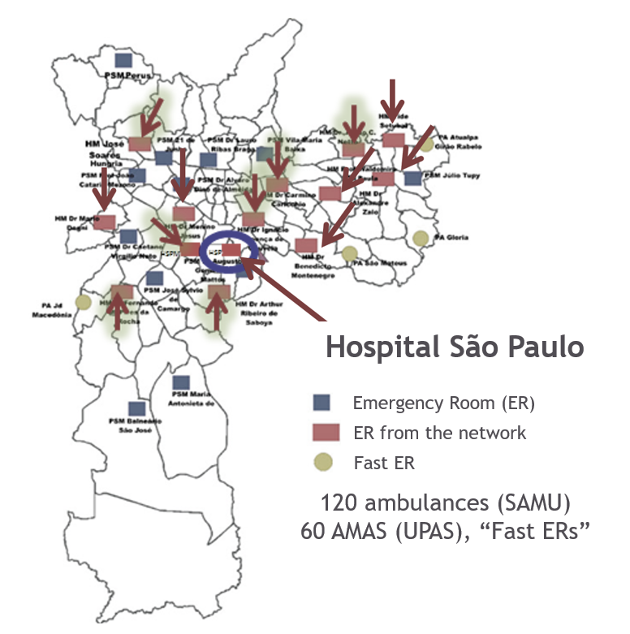
São Paulo STEMI network
2010 - Started with 5 spoke hospitals and a reperfusion strategy protocol
2018 - 14 spoke hospitals, 5 to 35 km from the hub hospital within the city of São Paulo
STEMI network features:
  Regular training sessions for staff of outskirt centres (physicians, emergency physicians, nurses, technicians)
  Single-call, cardiology mobile

Slide 22
The Vienna STEMI network
Established in 2003, the network consists of^{1,2}:
Viennese EMS
  Equipped with 12-lead ECG and devices for advanced life support
  Staffed with physicians or paramedics who can call an emergency physician if necessary
6 alternating tertiary cardiac centres with 24-h PCI capability
p=0.001
p=0.07
p=0.571
p=0.925
p=0.017
p=0.59

Slide 23
STEMI care in Indonesia:
Jakarta Cardiovascular Care Unit Network System
In-hospital mortality²
%
p=0.07
ARR=2.5%
RRR=26%
Demographic data on population and number of cardiologists and PCI centres¹
Location | Population | Mean number of board-certified cardiologists per million population | Number of PCI hospitals | Mean population per PCI centre
Indonesia | 239 000 000* | 2.74 | 88 | 2 715 909
Jakarta | 11 000 000* | 18.9 | 28 | 392 857
*Based on the National Surveillance 2010. The number of cardiologists and hospitals have been updated as of September 2014. PCI, percutaneous coronary intervention.
73†
†The mean number of board-certified cardiologists per million population in Belgium (which has a comparable population to Jakarta)
1. Dharma S et al. Open Heart 2015;2(1):e000240.
2. Dharma S et al. Asia Intervention 2018;4:92-97.

